Slide 1
PROTOTYPE DESIGN PATTERN
A Type of Creational Design Pattern

Slide 2
What is Creational Pattern?
They are design patterns that deal with object creation mechanisms, trying to create objects in a manner suitable to the situation.
They solve complexity problem which are related to objects by somehow controlling this object creation.

Slide 3
Prototype Pattern
Cloning an object by reducing the cost of creation.
The prototype object is responsible for cloning itself and returning the cloned object and not concerned with what kind of object its dealing with.

Slide 4
Benefits
When there are many subclasses that differ only in the kind of objects
Dynamic binding or loading a method
Use one instance to finish job just by changing its state or parameters
Add and remove objects at runtime

Slide 5
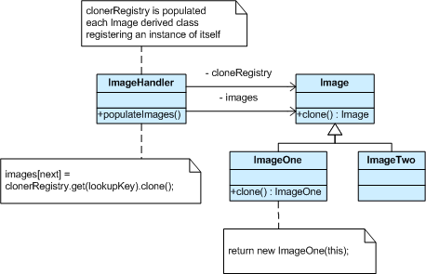
Explanation

Slide 6
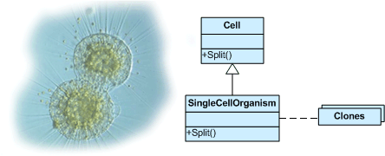
An Example

Slide 7
THANK YOU

